Slide 1

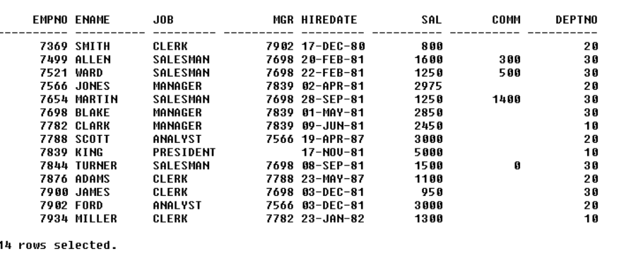
EMPLOYEE TABLE
INPUT:
OUT PUT:

Slide 2
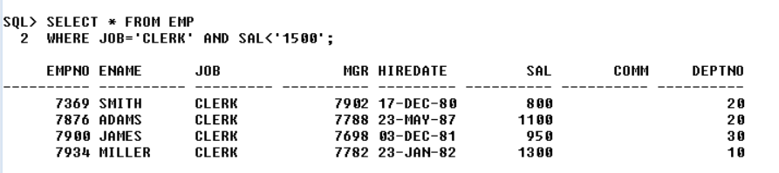
QUERY :
1.WAQTD DETAILS OF THE EMPLOYEES WORKING AS CLERK AND EARNING LESS THAN 1500
OUT PUT:

Slide 3
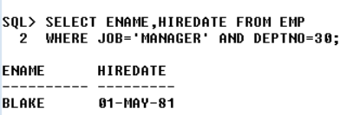
QUERY :
2.WAQTD NAME AND HIREDATE OF THE EMPLOYEES WORKING AS MANAGER IN DEPT 30.
OUT PUT:

Slide 4
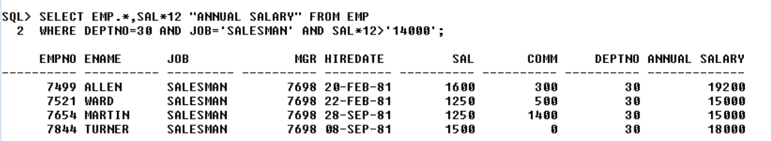
QUERY:
3.WAQTD DETAILS OF THE EMP ALONG WITH ANNUAL SALARY IF THEY ARE WORKING IN DEPT 30 AS SALESMAN AND THEIR ANNUAL SALARY HAS TO BE GREATER THAN 14000.
OUT PUT:

Slide 5
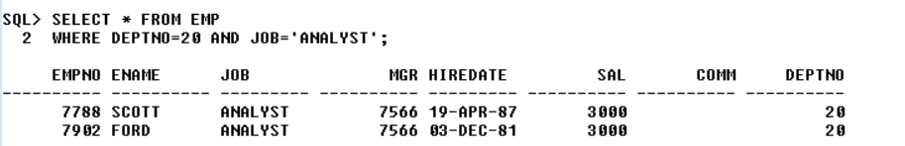
QUERY :
4.WAQTD ALL THE DETAILS OF THE EMP WORKING IN DEPT 30 OR AS ANALYST
OUT PUT:

Slide 6
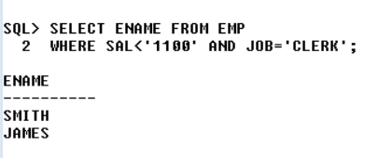
QUERY :
5.WAQTD NAMES OF THE EMPLOYEES WHOS SALARY IS LESS THAN 1100 AND THEIR DESIGNATION IS CLERK
OUT PUT:

Slide 7
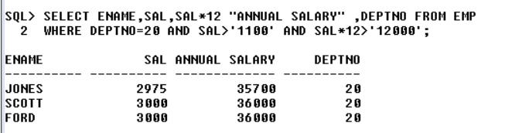
QUERY:
6.WAQTD NAME AND SAL ANNUAL SAL AND DEPTNO IF DEPTNO IS 20 EARNING MORE THAN 1100 AND ANNUAAL SALARY EXCEEDS 12000.
OUT PUT:

Slide 8
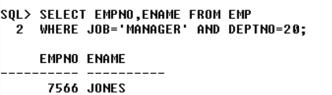
QUERY:
7.WAQTD EMPNO AND NAMES OF THE EMPLOYEES WORKING AS MANAGER IN DEPTNO 20.
OUT PUT:

Slide 9
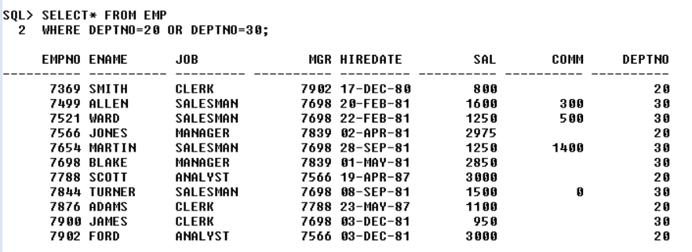
QUERY :
8.WAQTD DETAILS OF EMPLOYEES WORKING IN DEPTNO 20 OR 30 .
OUT PUT

Slide 10
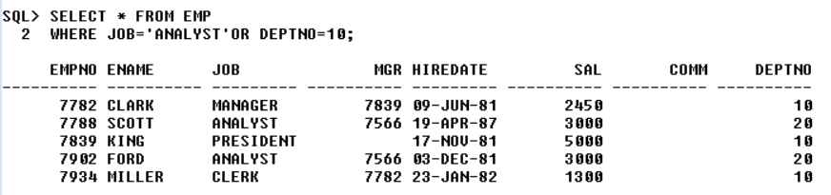
QUERY:
9.WAQTD DETAILS OF EMPLOYEES WORKING AS ANALYST IN DEPTNO 10.
OUT PUT:

Slide 11
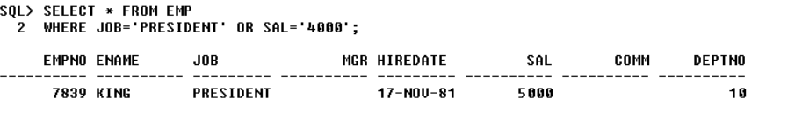
QUERY :
10.WAQTD DETAILS OF THE EMPLOYEES WORKING AS PRESIDENT WITH SALARY OF RUPEES 4000.
OUT PUT:

Slide 12
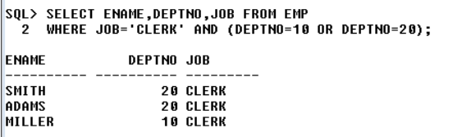
QUERY :
11.WAQTD NAMES AND DEPTNO JOB OF EMPS WORKING AS CLERK IN DEPT 10 OR 20.
OUT PUT:

Slide 13
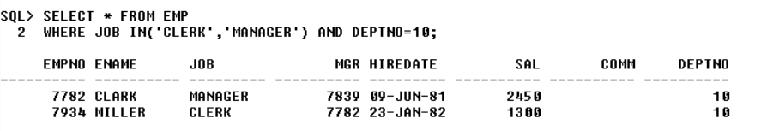
QUERY :
12.WAQTD DETAILS OF EMPLOYEES WORKING AS CLERK OR MANAGER IN DEPT 10.
OUT PUT:

Slide 14
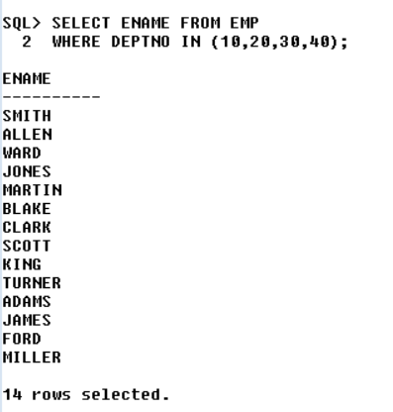
QUERY:
13.WAQTD NAMES OF EMPLOYEES WORKING IN DEPT 10,20,30,40.
OUT PUT:

Slide 15
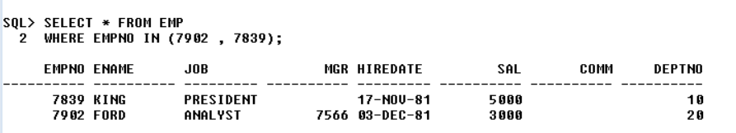
QUERY:
14.WAQTD DETAILS OF EMPLOYEES WITH EMPLOYEE NO 7902,7839.
OUT PUT:

Slide 16
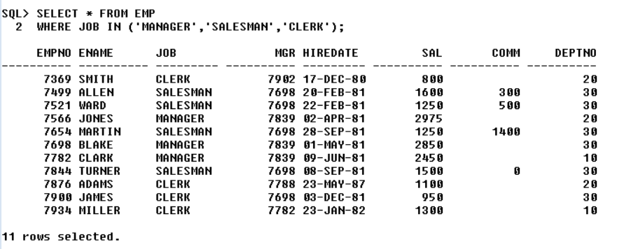
QUERY :
15.WAQTD DETAILS OF EMPLOYEES WORKING AS MANAGER OR SALESMAN OR CLERK.
OUT PUT:

Slide 17
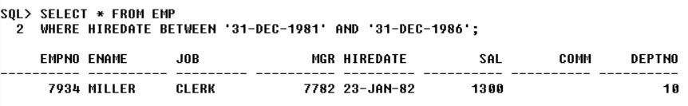
QUERY:
16.WAQTD NAMES OF EMPLOYEES HIRED AFTER 81 AND BEFORE 87.
OUT PUT:

Slide 18
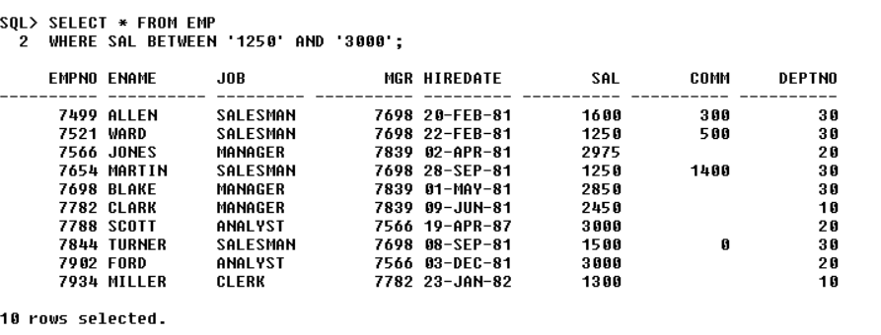
QUERY :
17.WAQTD NAMES OF EMPLOYEES EARNING MORE THAN 1250 BUT LESS THAN 3000.
OUT PUT:

Slide 19
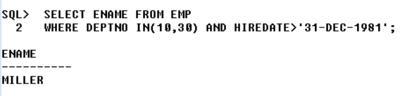
QUERY :
18.WAQTD NAMES OF EMPLOYEES HIRED AFTER 81 INTO DEPTNO 10 OR 30.
OUT PUT:

Slide 20
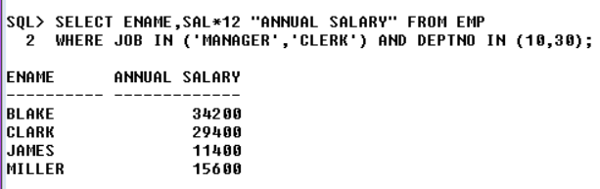
QUERY :
19.WAQTD NAMES OF EMPLOYEES ALONG WITH ANNUAL SALARY FOR THE EMPLOYEES WORKING AS MANAGER OR CLERK INTO DEPT 10 OR 30.
OUT PUT:

Slide 21
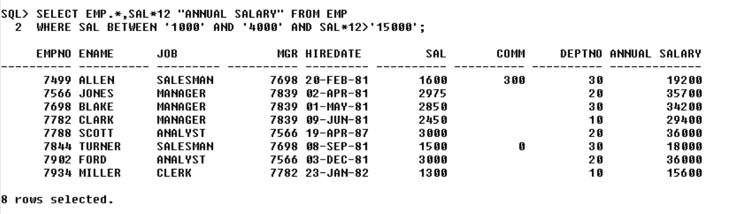
QUERY :
20.WAQTD ALL THE DETAILS ALONG WITH ANNUAL SALARY IF SAL IS BETWEEN 1000 AND 4000 ANNUAL SALARY MORE THAN 15000
OUT PUT:

